Slide 1
Simulation & Modeling 2019-2020
LAB 6

Slide 2
Reliability Problems
THE MILLING MACHINE

Slide 3
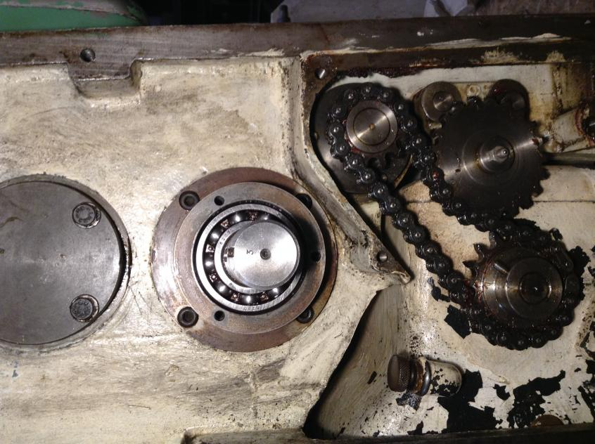
The Milling machine

Slide 4
The Milling machine
A large milling machine has three different bearings that fall in service .
When a bearing fails (a random variable), the mills stops, a repairperson is called, and a new bearing is installed.
The probability distribution function of the life of each bearing is identical as shown in the table [Slide 5]
The delay time of the repairperson’s arriving at the milling machine is also a random variable [Slide 6]
Notes:
A large milling machine has three different bearings that fall in service.
When a bearing fails, the mills stops, a repairperson is called, and a new bearing is installed.
The cumulative distribution function of the life of each bearing is identical as shown in the table
The delay time of the repairperson’s arriving at the milling machine is also a random variable
Downtime for the mill is estimated at $5 per minute.
The direct on site cost of the repairperson is $15 per hour
It takes 20 minutes to change one bearing, 30 minutes to change two bearings, and 40 minutes to change three bearings.
The bearings cost $16 each.
A proposal has been made to replace all three bearings whenever a bearing fails. Management needs an evaluation of this proposal.

Slide 5
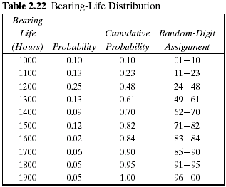
The Milling machine
Probability Distribution for the Life of bearing “Identical for all bearings”

Slide 6
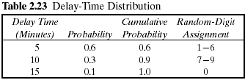
The Milling machine
Probability Distribution for the Delay Time of the repairperson

Slide 7

The Milling machine
Downtime for the mill → $5 per minute
The direct on site cost of the repairperson → $15 per hour
The bearings cost → $16 each

Slide 8
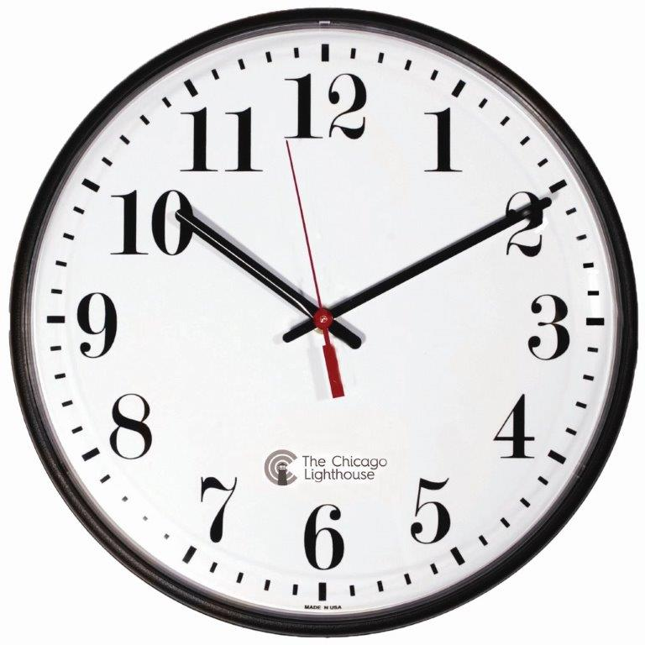
The Milling machine
Replace one bearing → 20 minutes
Replace three bearings → 40 minutes

Slide 9
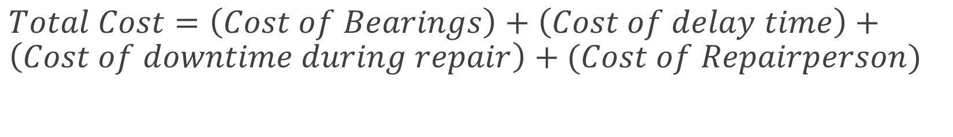
The Milling machine

Slide 10
The Milling machine
Current Policy | Proposed Policy
Whenever a bearing fails , replace it | Replace all three bearings whenever a bearing fails
Which policy is better?
A simulation scenario for the current and proposed policy must be conducted in order to take decision.

Slide 11
The Milling machine
The following Table (Table 2.24) represents a simulation of 20,000 hours of operation under the current method of operation.
Assumption
It will be assumed in this example that the times are never exactly the same, and thus no more than one bearing is changed at any breakdown. Sixteen bearing changes were made for bearings 1 and 2, but only 14 bearing changes were required for bearing 3.

Slide 12
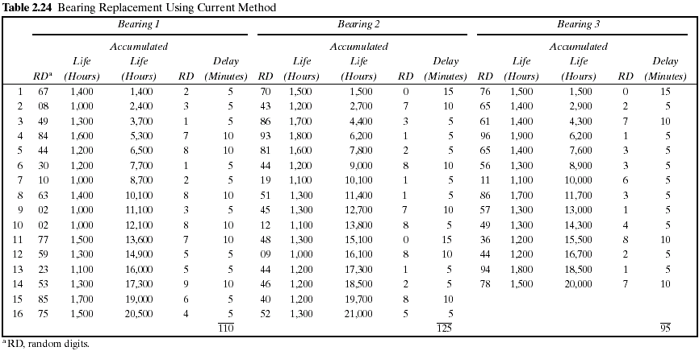

Slide 13
General Notes
Index is meant to be the position of the wheel in the machine and not a counter so it should be 1, 2, 3 (number of wheels per machine).
It’s not a must to display the data of each bearing in separate columns.

Slide 14
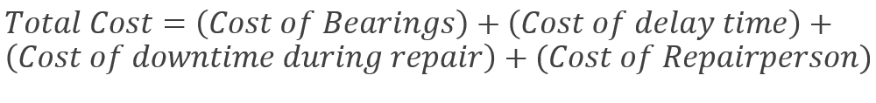
The Milling machine
The cost of the current system is estimated as follows:
Cost of bearings = 46 bearings × $16/bearing = $736
Cost of delay time = (110 + 125 + 95) minutes × $5/minute = $1650
Cost of downtime during repair =
46 bearings × 20 minutes/bearing × $5/minute = $4600
Cost of repairpersons =
46 bearings × 20 minutes/bearing × $15/60 minutes = $230
Total cost = $736 + $1650 + $4600 + $230 = $7216

Slide 15
The Milling machine
The following Table (Table 2.25) is a simulation using the proposed method.
Notice that bearing life is taken from Table 2.24, so that for as many bearings as were used in the current method, the bearing life is identical for both methods.

Slide 16
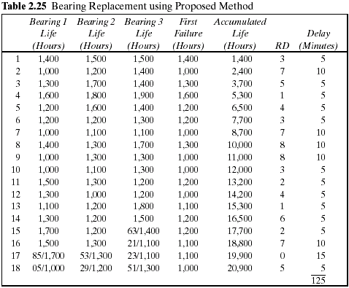

Slide 17
The Milling machine
Since the proposed method uses more bearings than the current method, the second simulation uses new random digits for generating the additional lifetimes.
The random digits that lead to the lives of the additional bearings are shown above the slashed line beginning with the 15th replacement of bearing 3

Slide 18
The Milling machine
The total cost of the new policy :
Cost of bearings = 54 bearings × $16/bearing = $864
Cost of delay time = 125 minutes × $5/minute = $625
Cost of downtime during repairs = 18 sets × 40 minutes/set × $5/minute = $3600
Cost of repairpersons = 18 sets × 40 minutes/set × $15/60 minutes = $180
Total cost = $864 + $625 + $3600 + $180 = $5269
Notes:
54 bearings = 18 row * 3 bearings

Slide 19
The Milling machine
Total Cost of Current policy = $ 7216
Total cost of Proposed policy = $ 5269
The new policy generates a savings of $1947 over a 20,000-hour simulation.

Slide 20
System Input
Number of hours (stopping condition)
Number of Bearings
Bearing Life distribution
Delay time distribution
Bearing Cost
Downtime Cost
Repairperson Cost
Repair Time/Bearing
Repair Time/All Bearings

Slide 21
System Output
1. A Simulation Table for the Current Policy with the columns below
Bearing Number (Serial Number for the bearing being replaced)
For every bearing:
Random Digit for bearing life
Bearing Life
Accumulated Bearing Life
Random Digit for delay time
Delay Time
N.B: Also show the total delay time

Slide 22
System Output
2. A Simulation Table for the Proposed Policy with the columns below
Bearing Number (Serial Number for the bearing being replaced)
For every bearing:
Bearing Life
First Failure
Accumulated Bearing Life
Random Digit for Delay Time
Delay Time
N.B: Also show the total delay time

Slide 23
System Output
3. A results window showing:
For each of the current & proposed method:
Total Bearing Cost
Total Delay Cost
Total Downtime Cost
Total RepairPersonCost
Total Cost

Slide 24
Task (3) Deliverables
The complete two simulation tables
The results window
Reading Inputs from file

Slide 25
Task (3) Delivery Rules
Task delivery next week
Every team should commit to their assigned time slot [same as Task(1) & Task (2)]
Any delay will not be accepted
Cheating Policy
First Incident: -10% from the yearwork grades
Second Incident: -50% from the yearwork grades
Third Incident: -100% from the yearwork grades

Slide 26
More Notes
GUI is mandatory (Input-Output forms).
Reading from file is mandatory.
Well OOP design is mandatory.
This task should be implemented by 2 team members (one will implement the current policy and the other will implement the proposed policy).

Slide 27
Template Walkthrough

Slide 28
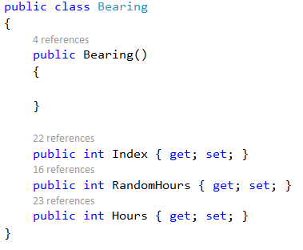

Slide 29
The Milling machine
Probability Distribution for the Life of bearing “Identical for all bearings”

Slide 30
The Milling machine
Probability Distribution for the Delay Time of the repairperson

Slide 31
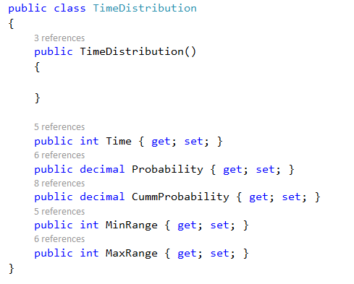

Slide 33
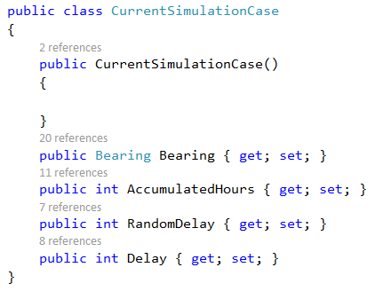

Slide 35
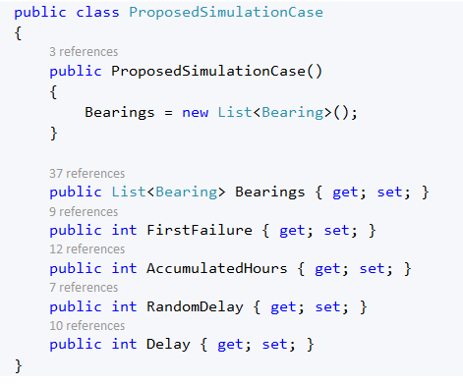

Slide 36
The Milling machine
The total cost of the new policy :
Cost of bearings = 54 bearings × $16/bearing = $864
Cost of delay time = 125 minutes × $5/minute = $625
Cost of downtime during repairs = 18 sets × 40 minutes/set × $5/minute = $3600
Cost of repairpersons = 18 sets × 40 minutes/set × $15/60 minutes = $180
Total cost = $864 + $625 + $3600 + $180 = $5269

Slide 37
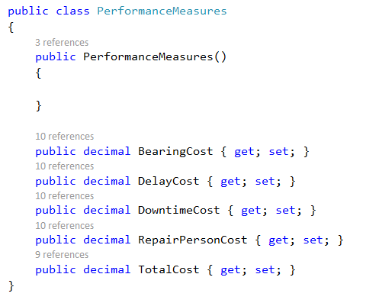

Slide 38
System Input
Number of hours (stopping condition)
Number of Bearings
Bearing Life distribution
Delay time distribution
Bearing Cost
Downtime Cost
Repairperson Cost
Repair Time/Bearing
Repair Time/All Bearings

Slide 39
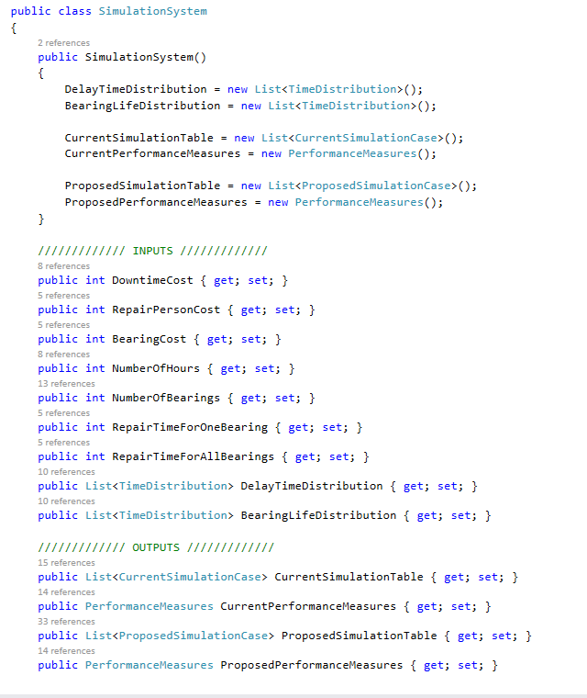

Slide 40
Using TestCases
You are given a testcase to run that will provide with a message
Success message if your code runs correctly.
Error message describing the failed part.
Running using testcases
Your system object

Slide 41
Thank You

